Slide 1
E-Dawam Project For Direct-online Employment and Managing Tasks Online

Slide 2
Harakia Organization
E-Dawam Project Owner
Harakia organization for the Handicapped is committed to providing services and programs which enable handicapped individuals to obtain higher levels of physical well-being, pride, independence, and self-esteem.
We work with disabled people, their families and careers to provide a mix of services that meet their aspirations at all stages of their lives.
We are also a campaigning organization, committed to using our strong influence to ensure disabled people achieve the same human and civil rights as the rest of society.

Slide 3
Project Operator (Moltqa)
Moltqa Software House is a custom software development and consulting company with offices in Jeddah, Alexandria.
Our services are not limited to outsourcing for software vendors and custom application development for ultimate customers. We also provide managerial services and analysis, web sites/graphic design, quality and comprehensive testing for existing software solutions, full time software support for developed solutions, IT consulting and remote administration.IT consulting and remote administration.
We are here for the long term and have been providing innovative and high-quality project management, engineering and design for major software projects for more than 7 years.
For more information visit our website
http://qvsite.com/

Slide 4
What Is E-Dawam Project?

Slide 5
About E-Dawam
E – Dawam Employment Bureau holds a license of the Ministry of Labor ,No. 388 for the year 1434 AH., Specialized in…
Direct employment
Online Employment
Management system for online work
About E-Dawam

Slide 6
Mission
«E - Dawam» is The largest technical system for recruitment and business management for Handicapped and their families in Saudi Arabia by creative and practical solutions.
Mission

Slide 7
Vision
We seek to resettle genuine and guaranteed 10,000 jobs in Saudi Arabia annually during the first five years of the launching of the project.
Vision
For more information visit our website
www.edawam.com

Slide 8
Beneficiaries
Serious job seekers with different disabilities (Physically, blinds, diffs) and their families.
Companies searching for special and national cadres.
Managers who are searching for a system that helps in evaluating and managing their employees easily.

Slide 9
The Process Stages
Preparation needed for the project work flow and visualization To manage the recruitment process through smart technologies.
Extract the Employment Bureau's license of the Ministry of Labor.
Preparing a Programmatic and administrative software for the implementation of portal as a front for the main Employment Bureau .
Gathering approved data by the Ministry of Labor, considering job activities and types of disabilities and use it in the portal.
Implementing a software system for managing online employment and linking withthe portal.
we use a set of studies and statistics on the latest labor laws in Saudi Arabia.
Follow-up rates of relocation in Saudi Arabia, and extract reports to implement techniques to fight Saudization
Follow-up job seekers of handicapped in Saudi Arabia to determine the size of the target segment and their needs.
Study the previous hiring way in Harakia, and take advantage of the positives items and find the solutions for negatives.

Slide 10
Axes Of E-Dawam
E-Dawam Portal
E-Task
E-Marketing campaign

Slide 11
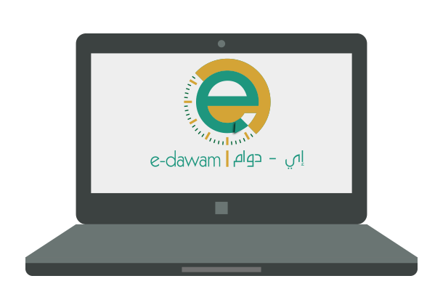
Portal «E-Dawam »
Video Tutorials
Search
Registration
Tasks Management System
Technical Support
Human Resources Development Articles
Edit User Profile
Content Sharing

Slide 12
The Implementation phases for the portal
Operating
development
Launching

Slide 13
E-Dawam Portal Sprints
Executing the project was based on Scrum methodology. The project has been divided into several phases. Designing the portal … the first and second phases have been finished as shown below :
First phase : sprint 1 | Steps of creating basic info for registering in the portal for employee / company
 | Steps to complete the data
 | Logos review
 | viewing list of updated recommended jobs for employee
 | Implementing the favorite list properties for employee / company
 | Search properties for employees and the company
 | Implementation of archive page to backup jobs in the employee profile
 | Implementation of archive page to backup all data in the company profile
 | viewing profile as others see it
First phase : sprint 1 | Reviewing a list of interviews for the company
 | Access to social networks which belong to E-Dawam portal
 | Quick Registration and subscription to mailing list for the portal .
 | Viewing the guiding Videos in the portal in addition to the YouTube channel of E-Dawam
 | The ability of sending an email to the website management through “contact us”
 | Viewing articles (about E-Dawam / frequently asked questions / privacy policy)
 | Implementing specialist control panel for managing the portal that contains some properties “job seekers management / companies management / portal content management / contact us management / interviews management / users management"

Slide 14
مراحل تنفيذ بوابة «إي-دوام»
E-Dawam Portal Sprints
Second phase: sprint 2 | implementation of E-dawam mobile version
 | The allocation of a mobile version for recording employee data and look at the articles of tariff for the project
 | Implementing the property of reporting for both of employee / company in the portal
 | “Completing the portal control panel properties” The portal settings
 | Setting properties of reporting control in E-Dawam portal

Slide 15
«E-Task» Remote system management
Send tasks
”attachments / comments”
E-task is a Remote system control application that offers practical solutions to integrate communications and follow-up assigning, tracking, monitoring, and deliver, tasks between companies and employees remotely . It provides information about tasks in a Task Management system. It exports reports and statistics with finished tasks, projects, resources.
Also it helps resources to manage their tasks easily.
manager
Accept or reject tasks
employee
Receiving task
“after confirmation”
Add attachment
Add comments
Determine number of hours required to accomplish the task
Send finished tasks
manager
Evaluate the company
Review task log
Evaluate the employee
Review task log
statistics
reports
re- assgin or finish task

Slide 16
E-task Sprints
Executing the project is based on Scrum methodology. The project has been divided into several phases. Designing the portal … first phase have been finished as it shown below :
Common Scenarios between company and employee | ability to Login as a company , an employee by email and password that had been registered on e-dawam.
 | Add and report comments on tasks from both sides. Company can show/hide any comments.
 | Add attachments from both sides as soon as task is not finished yet.
 | Follow up tasks by using “task log" feature that shows all task actions have been done by the two sides (company- employee)
 | Receive notifications with any action has been done on tasks by the two sides (company- employee)

Slide 17
E-task Sprints
Company scenarios | Manage its tasks by review, add, edit, assign, re-assign, pause, delete, reject, confirm and archive tasks.
 | add task priority
 | Re-assign task to another employee, and it is automatically paused for the current one.
 | Manage projects (review its tasks, add, edit, delete).
Employee scenarios | Manage his tasks (accept, reject, add daily tasks time it takes, finish) tasks.
 | Edit task status (new, in progress, finished).

Slide 18
E-marketing campaign
Campaign goals for E-Dawam Portal
Publicize and disseminate the Portal and Build up our website’s visibility
Access to a huge database of CVs
Interaction with the Saudi citizens to know their requirements and determine methods to provide them.
Build Trust between E-dawam and the Saudi citizens
Targeted marketing campaign
specifically :handicapped Job seekers
Generally: Saudi society

Slide 19
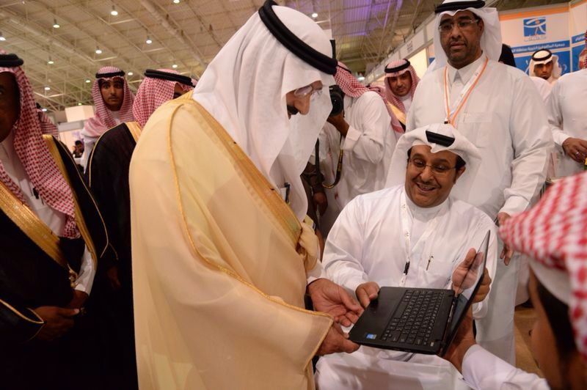
Launching E-Dawam Portal
Launching E-Dawam Portal during the first national forum for the employment of handicapped
Prince Khalid bin Bandar bin Abdulaziz, Governor of Riyadh, His Excellency the Mayor of Riyadh Region, officially launched E-Dawam project (Offers opportunities for people with disabilities Including a job finder sections)during the first national forum for the employment of men and women with special needs and its accompanying exhibition.
The three-day forum themed "My job is my security" was held under the auspices of Riyadh Emir Prince Khalid Bin Bandar, at Riyadh International Convention & Exhibition Center from May 11.

Slide 20
An Operational and Management Mechanism
The First Phase
Conciliation and administrative aggregation between companies and employees
Suggest the best job vacancies for job seekers by using administrative steps with a Specialized team.
send periodical job suggestions by emails to portal participations
Using “Contacts us” page helps in following up all requests.
Continues updating “help videos” to explain portal features to help visitors.
Publish human development articles with good recommendations to improve remote employment skills.
Our managerial team for employees and corporate staff makes sure of the validity of the registration data at the portal before activating their accounts.
Making sure of registration data validity at the portal before activating their accounts by our employees and corporate management team.
Using administration email of companies/employees to follow up and be connected with them.

Slide 21
An Operational and Management Mechanism
The Second Phase
“Interaction between companies and employees using E-Dawam portal”…
Ability to search for employees and companies.
Advanced search helps both sides in finding the most suitable results.
Companies add employees to “favorite list” to choose from.
After choosing employees, the company adds suitable employees into “interview list” where they can view their contact information.
Employee can add jobs into “favorite list” or apply for jobs.
Ability to follow up their tasks easily by using e-task management system.
Portal admin Following up Employment procedures for the employees added to “interview list”.
Following up remote Employment by using periodical (reports /statistics).

Slide 22
Human resources and team work
Project team work
8 | Developers
3 | Graphic designers and multimedia
2 | Marketing campaign management
4 | Portal management
3 | Testing and analysis of information systems
3 | Stuffing and companies coordinators (in Harakia)

Slide 23
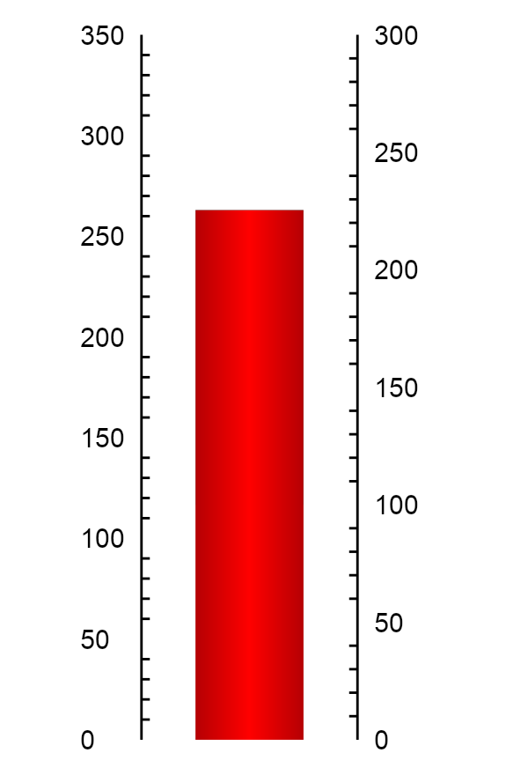
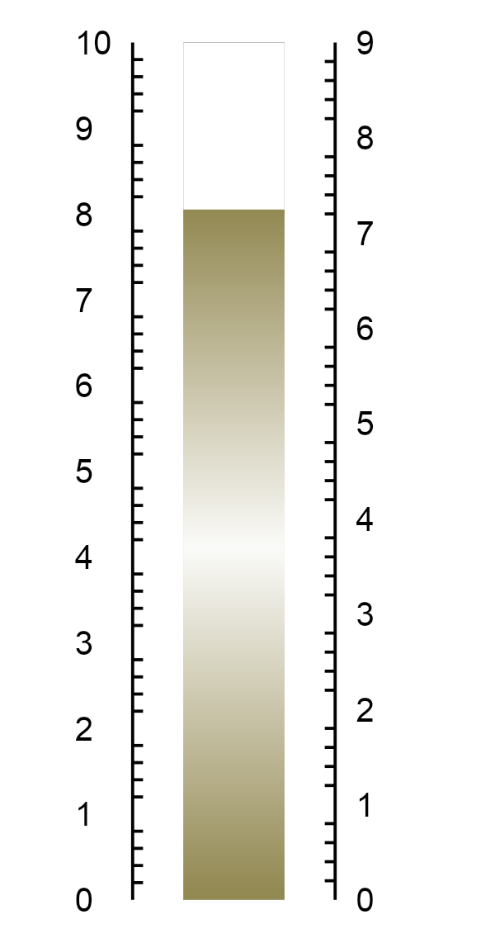
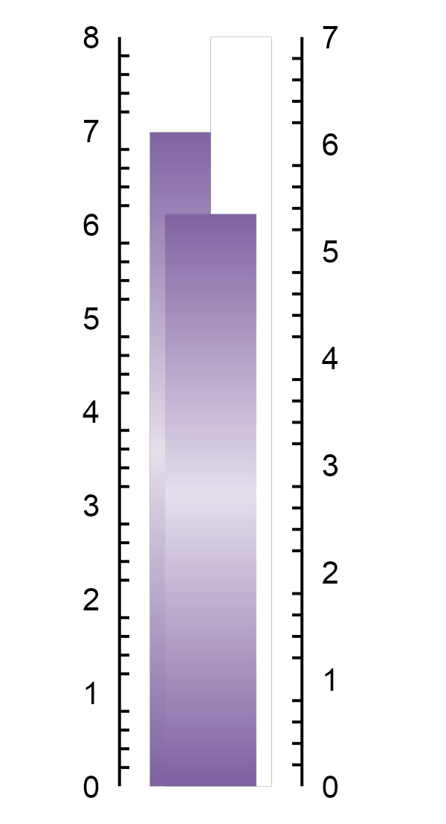
Facts and figures
Ratios of visiting the website
Statistics below refer to the rates of the visit to the website since the launch of the project: 12 Rajab1435 Hijri to 26 Rajab1435 Hijri.
263 Visitor
6.11 Pages/Session User
8.05 Avg. Session Duration

Slide 24
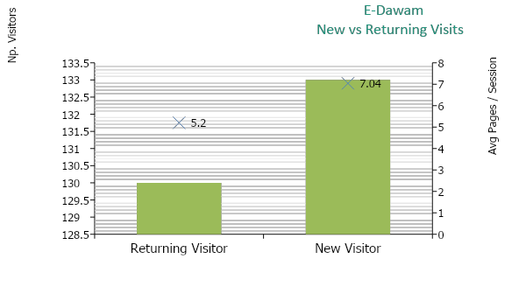
Facts and figures
People who are interested in the website
The Figure indicates that visits from new visitors is estimated at 133 visits while 130visits from returning users, which is good.

Slide 25
Facts and figures
The Campaign Period: 3Th Months
Statistics below refer to the rates since the launch of the project from 12 Rajab1435 Hijri to 26 Rajab1435 Hijri.
Marketing Campaigns
 | Twitter
 | 71
 | Followers
 | 142
 | Followers
 | 5
 | Views
 | 1445
 | Likes
 | 155
 | Views
 | 197
Google plus
Mobile Application
You tube
Facebook
Twitter

Slide 26
Watch The latest's videos for E-Dawam Channel on You tube
Marketing video
http://www.youtube.com/watch?v=IPETSisjJDE
Quick register on portal
http://www.youtube.com/watch?v=TyEfFc2STis
Employee’s register on the portal
http://www.youtube.com/watch?v=aoTtwMlB0gE
Company’ register on the portal
http://www.youtube.com/watch?v=kPoRQpB46Wc
Steps to assign a task on (E-Task)
http://www.youtube.com/watch?v=F9vXDnd5A2A

Slide 27
Best Regards,,,

